Slide 1
Data Science Programming
Final Project - D&D Spells
Charlie Buhanan

Slide 2
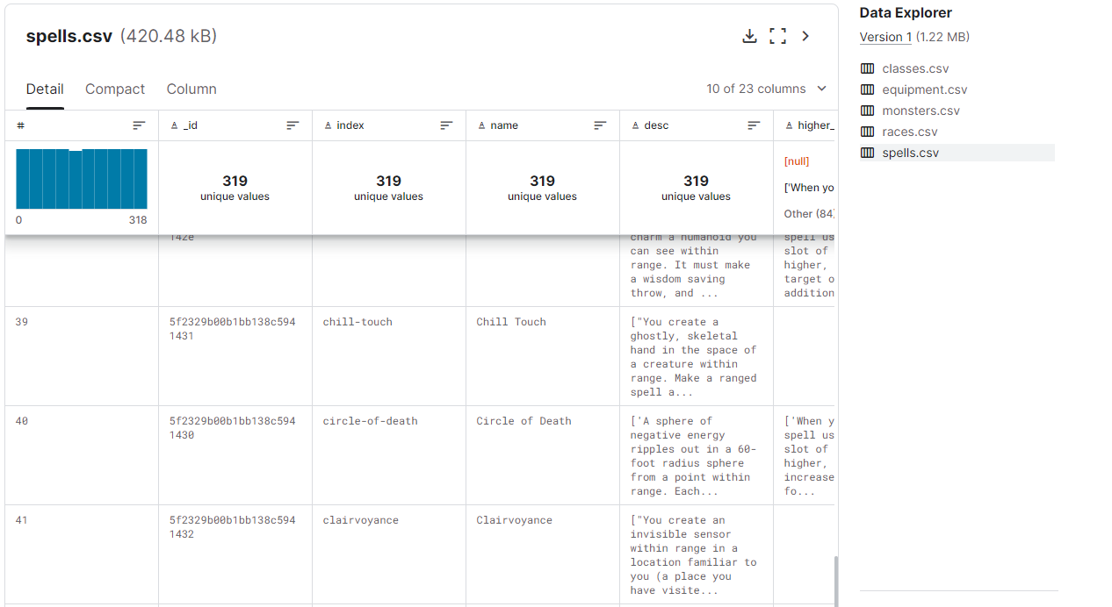
Source - Dungeons & Dragons on Kaggle
This source has a collection of information on Dungeons & Dragons spells, races, equipment, monsters, and classes. It is very detailed and is derived from the D&D 5th Edition API. While I only used the spells dataset, there is a lot more to explore.

Slide 3

Tools & Resources
Jupyter Notebook
Kaggle
Excel / Google Sheets
Python Packages: Matplotlib, Seaborn, Pandas
Resources: W3 Schools, ChatGPT, Seaborn Documentation

Slide 4

Main Questions
What is the average spell level?
What types of components are required to cast spells? What types are most common?
What percentage of spells are rituals?
What is the average casting time for a spell?

Slide 5

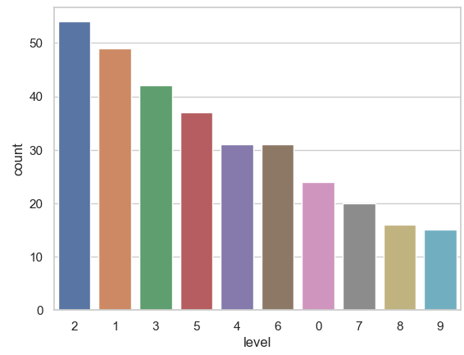
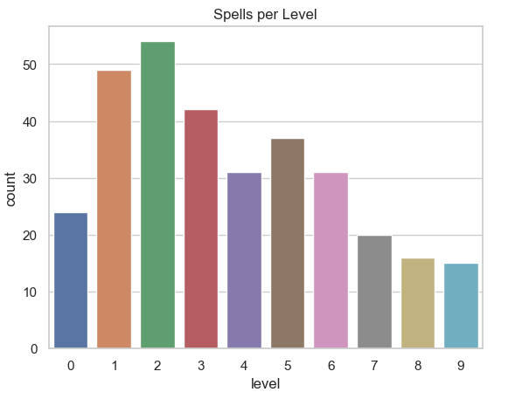
Question 1
What is the average spell level?

Slide 6
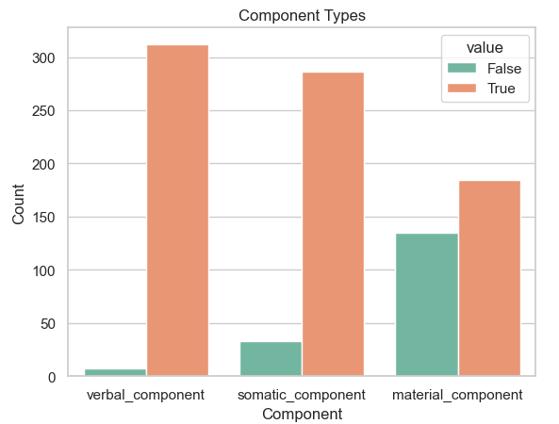

Question 2
What types of components are required to cast spells? What types are most common?

Slide 7
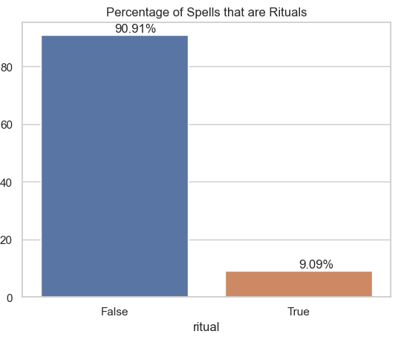
Question 3
What percentage of spells are rituals?

Slide 8
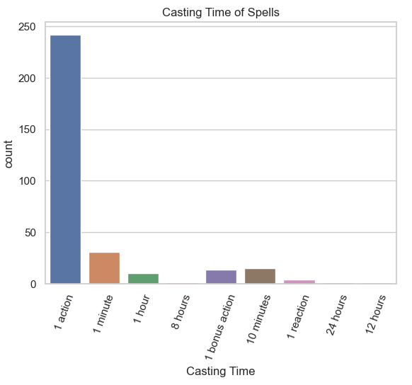
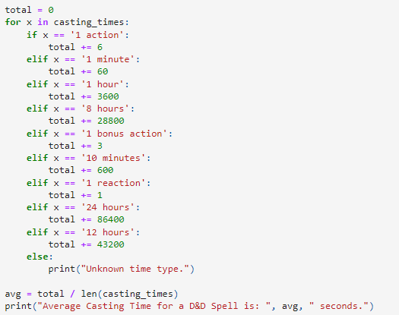
Question 4
What is the average casting time for a spell?

Slide 9

Thanks for watching
Any questions?

